Slide 1
Andrea zick
Bsc Nutrition and Health

Slide 2
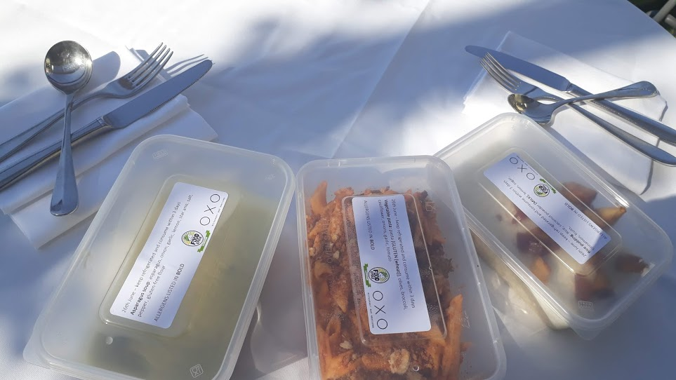
Food Hero of the Year

Slide 3
Nominated for work in Community Kitchens
Bia Project Irish Centre Lewisham
OXO Community Kitchen

Slide 4
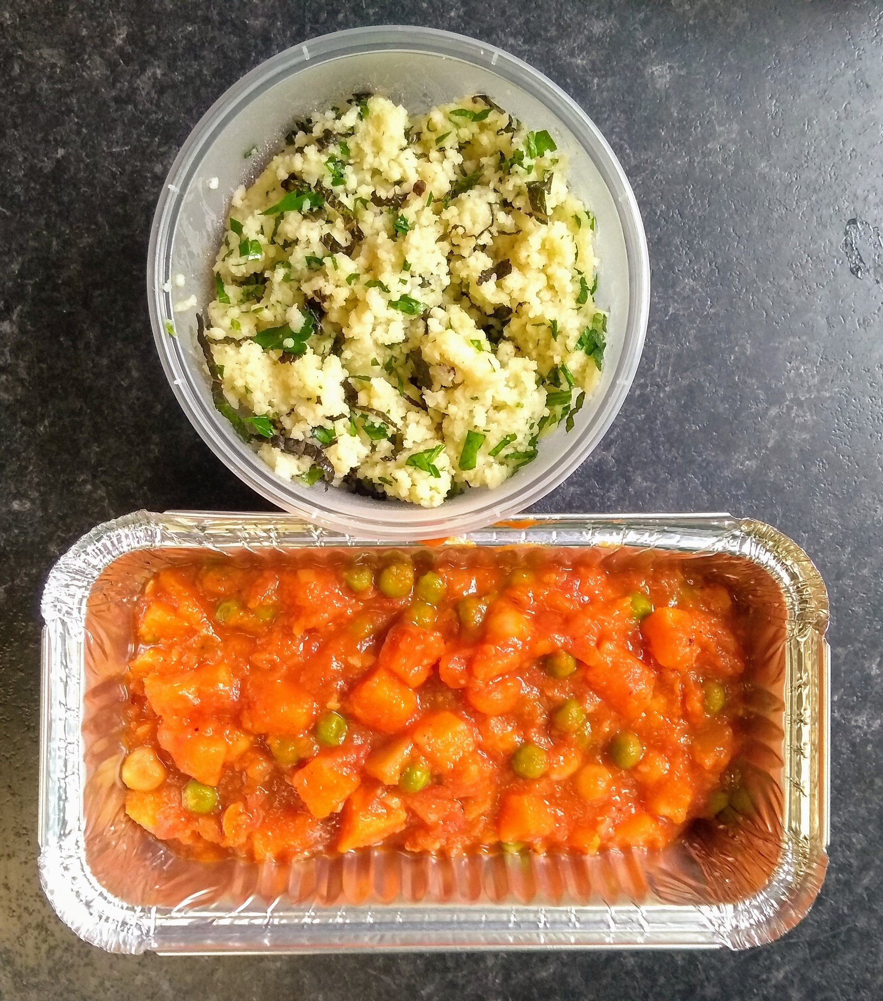
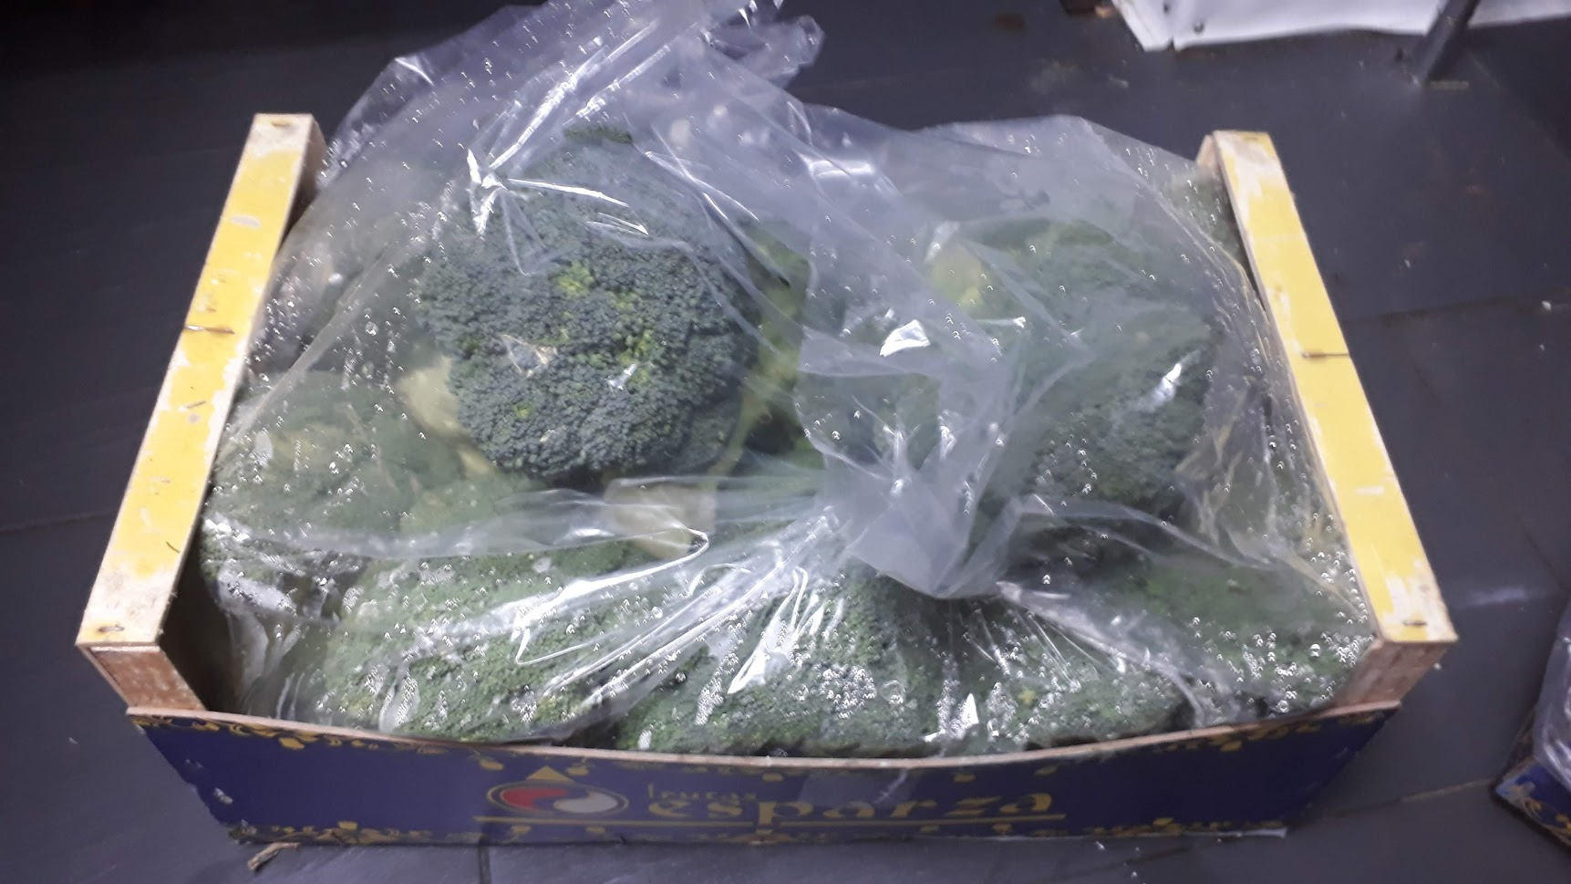
Bia Project Timeline
19 Mar. 2020
Connected with the Team from Catford Fridge when dropping off surplus food from the OXO Tower Restaurant expecting to be furloughed any day.
15 Apr. 2020
First 24 Meals cooked and delivered for the regular older visitors of the Irish Centre.
Meals were plant based / vegan.
Cooked fresh and delivered on the day with help of Wheels4Wellbeing
15 July 2020
My last cooking session.
Prepared more then 450 meals
Project continued with help of a local café which I recommended as a future support
23 Mar. 2020 start of lockdown
Notes:
https://twitter.com/lewishamlocal/status/1264244840323219457?s=20

Slide 5
https://twitter.com/lewishamlocal/status/1264244840323219457?s=20

Slide 6
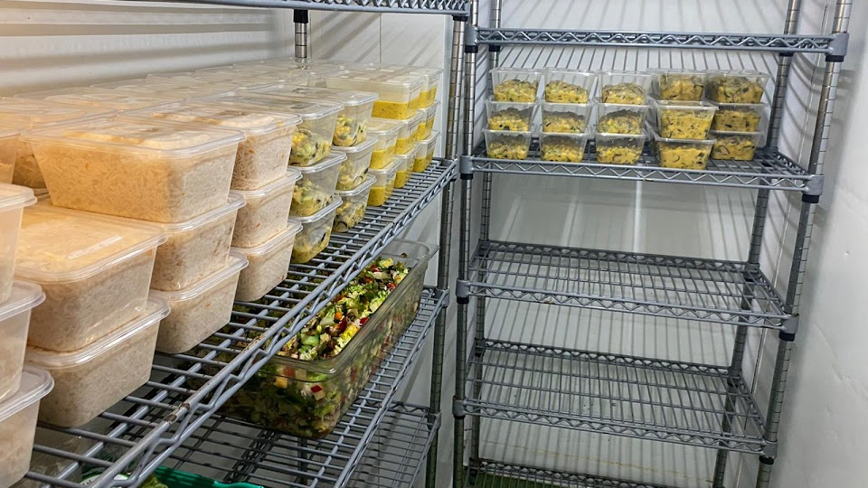
OXO Community Kitchen Timeline
7 May 2020
GM of the OXO Tower Restaurant, Bar and Brasserie receives approval to use premises to cook community meals
I emailed any possible contact to find organisations which needed meals and could help to get surplus food and logistics set up
30 May 2020
30 Meals (starter, main and dessert) cooked and picked up from Food Cycle Lewisham
Meals were plant based / vegan cooked fresh on the day and picked up and delivered by Food Cycle.
Their guests are a mixture of vulnerable people who are either lonely, older, suffer with mental health issues, disabled or several of these.
22 Aug. 2020
Last cooking session.
Prepared more then 12 000 meals between May and August using over 4 tons or surplus food.
Project delivered meals to five different organizations Food Cycle Lewisham, FEAST with Us, Coin Street Community, Tennis2Be, Streets Kitchen
Project due to be re-started in November to cook meals for Streetskitchen

Slide 7
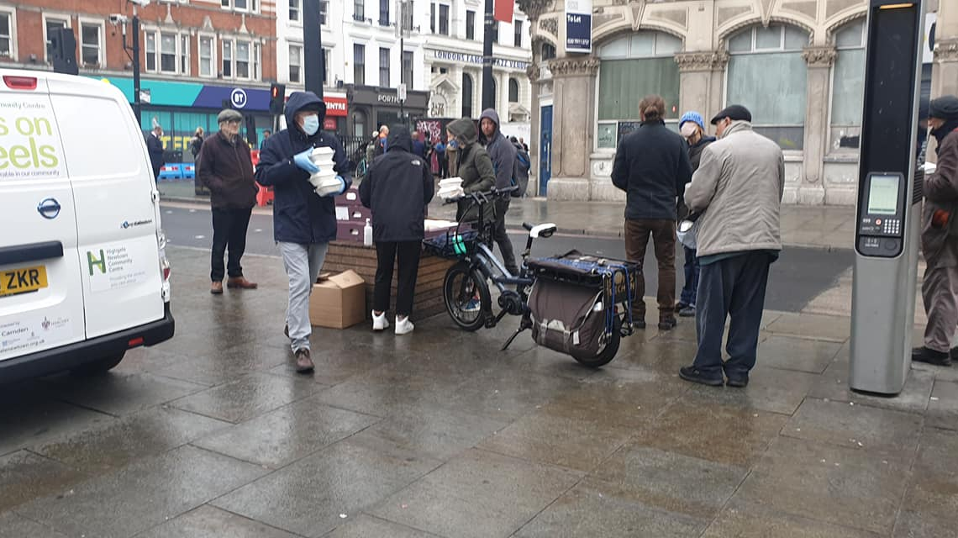
Community kitchens Serve/D
Older Londoners who were self-isolating and or unable to fend for themself
Children and families who would normally receive free school meals
People with disabilities /illness who had to self-isolate
Homeless and people with multiple addictions
The general public by minimising food surplus and thus associated Co2 emissions
The general public by improving the health and well-being of vulnerable people thus reducing health care costs
My colleagues and other people in the community who chose volunteering as means of improving their mental well being

Slide 8
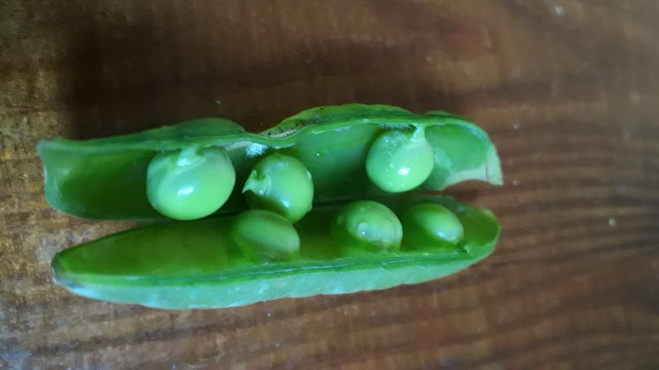
Challenges are just Opportunities in Disguise
Excess food from the OXO Tower Restaurant closure and being put on furlough
Building brand new trust relationships
Unknown risk and transmission route of Covid required risk assessments
Food Safety and Allergy Safety for vulnerable people was a must
Ensuring the cooling chain is maintained
Finding a supplier for the Bia Project and a partner for the delivery
Convincing OXO Tower Management to open their kitchen
Finding suitable charity partners
Scaling up to several hundred meals a day at OXO
Scaling it down when the restaurant re-opened
Cooking and packaging 1200 meals in a day

Slide 9
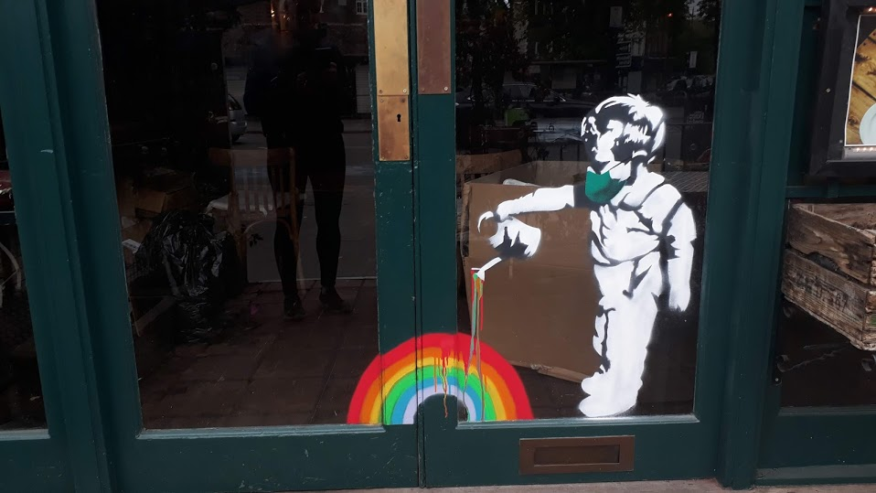
Food Hero of the Year - what it means to me
Actively setting up community kitchens and cooking many thousands of plant based meals this year was simply the right thing to do.
This year has taken so much from all of us so the only way to deal with this grief is by giving back and coming together.
Food allows communities to come together and heal and this will remain true the year of Covid shattered the world.

